Slide 1
Time Series
A time series is a collection of observations made sequentially through time.
Eg occur in a variety of fields, ranging from economics to engineering, and
Methods of analysing time series constitute an important area of statistics

Slide 2
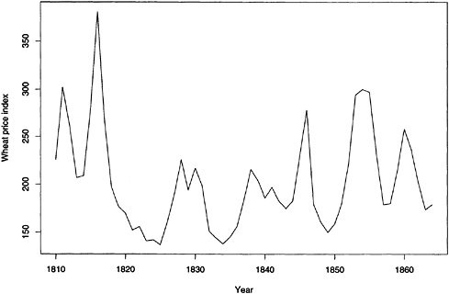
Time Series
Economic and financial time series

Slide 3
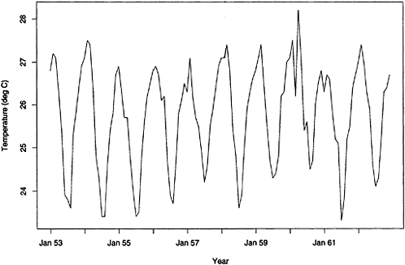
Time Series
Physical time series:
In meteorology, marine science and geophysics.
Examples
Rainfall on successive days, and
Air temperature measured in successive hours, days or months.
Figure shows the average air temperature at Recife (Brazil) in successive months over a 10-year period and seasonal fluctuations can be clearly seen.

Slide 4
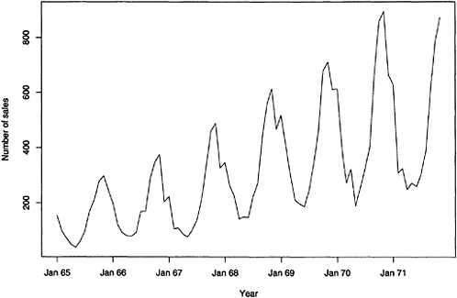
Time Series
Marketing time series:
The analysis of time series arising in marketing is an important problem in commerce.
Observed variables could include sales figures in successive weeks or months, monetary receipts, advertising costs and so on.
Figure shows the sales of an engineering product by a certain company in successive months over a 7-year period.
Note the trend and seasonal variation which is typical of sales data. As the product is a type of industrial heater, sales are naturally lower in the summer months.
It is often important to forecast future sales so as to plan production.
It may also be of interest to examine the relationship between sales and other time series such as advertising expenditure.

Slide 5
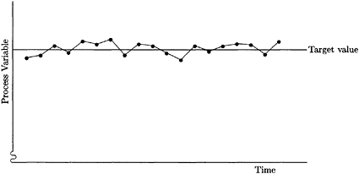
Time Series
Process control data:
Here the problem is to detect changes in the performance of a manufacturing process by measuring a variable, which shows the quality of the process.
These measurements can be plotted against time as in Figure.
When the measurements stray too far from some target value, appropriate corrective action should be taken to control the process.

Slide 6
Objectives of Time-Series Analysis
Objectives may be classified as:
Description,
Explanation,
Prediction and
Control

Slide 7
Objectives of Time-Series Analysis
1. Description
First step in the analysis:
Time plot : Plot the observations against time and
Descriptive measures of the main properties of the series.
Power of the time plot as a descriptive tool: demonstrate
Regular seasonal effect - with sales ‘high’ in winter/ ‘low’ in summer, or
Trends -show increase in annual sales(i.e. upward trend).
Reveal any ‘wild’ observations or outliers that do not appear to be consistent with the rest of the data.
The treatment of outliers: An outlier may be perfectly valid (fraud cases), or when a recording device goes wrong or when a strike severely affects sales.
Other features to look for in a time plot:
Sudden or gradual changes in the properties of the series.
Possible presence of turning points, where, for example, an upward trend suddenly changes to a downward trend.
If there is some sort of discontinuity in the series, then different models may need to be fitted to different parts of the series.
1. For some series, the variation is dominated by such ‘obvious’ features, and a fairly simple model, which only attempts to describe trend and seasonal variation, may be perfectly adequate to describe the variation in the time series.
2. For other series, more sophisticated techniques will be required to provide an adequate analysis.

Slide 8
Objectives of Time-Series Analysis contd…
2. Explanation
When observations are taken on two or more variables, it may be possible to use the variation in one time series to explain the variation in another series.
3. Prediction/ Forecasting
Given an observed time series, one may want to predict the future values of the series.
Important task in sales forecasting- in the analysis of economic and industrial time series.
4. Control
Time series are sometimes collected or analysed so as to improve control over some physical or economic system.
For example, when a time series is generated that measures the ‘quality’ of a manufacturing process, the aim of the analysis may be to keep the process operating at a ‘high’ level.
Control problems are closely related to prediction in many situations. For example, if one can predict that a manufacturing process is going to move off target, then appropriate corrective action can be taken.

Slide 9
Approaches to Time-Series Analysis
Various approaches to time-series analysis are:
simple descriptive techniques, which include plotting the data and looking for trends, seasonal fluctuations and so on.
a variety of probability models exist for time series, and discusses ways of fitting these models to time series.
A major diagnostic tool is a function called the autocorrelation function, which helps to describe the evolution of a process through time.
Inference based on this function is often used in analysis in time domain.

Slide 10
Univariate Time Series Models
The term "univariate time series" refers to a time series that consists of single (scalar) observations recorded sequentially over equal time increments.
Some examples are monthly CO₂ concentrations and closing prices of share market prices
Although a univariate time series data set is usually given as a single column of numbers, time is in fact an implicit variable in the time series.
If the data are equi-spaced, the time variable, or index, does not need to be explicitly given.
The time variable may sometimes be explicitly used for plotting the series. However, it is not used in the time series model itself.

Slide 11
Stationarity
A common assumption in many time series techniques is that the data are stationary.
A stationary process has the property that the mean, variance and autocorrelation structure do not change over time.
Stationarity can be defined in precise mathematical terms.
Essentially, it means a flat looking series, without trend, constant variance over time, a constant autocorrelation structure over time and no periodic fluctuations (seasonality).
For practical purposes, stationarity can usually be determined from a run sequence plot.
Autocorrelation, also known as serial correlation, is the correlation of a signal with a delayed copy of itself as a function of delay. Informally, it is the similarity between observations as a function of the time lag between them. The analysis of autocorrelation is a mathematical tool for finding repeating patterns, such as the presence of a periodic signal obscured by noise,

Slide 12
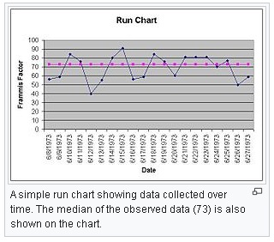
A run chart/ a run-sequence plot
Is a graph that displays observed data in a time sequence.
Often, the data displayed represent some aspect of the output or performance of a manufacturing or other business process.
It is therefore a form of line chart.

Slide 13
Tranformations to Achieve Stationarity
Transform to stationarity with one of the following techniques.
Difference the data: Given the series Zt, create the new series Yi= Zi − (Zi−1).
(The differenced data will contain one less point than the original data. Although you can difference the data more than once, one difference is usually sufficient).
If the data contain a trend: fit some type of curve to the data and then model the residuals from that fit. (Since the purpose of the fit is to simply remove long term trend, a simple fit, such as a straight line, is typically used).
For non-constant variance: taking the logarithm or square root of the series may stabilize the variance.
For negative data: add a suitable constant to make all the data positive before applying the transformation. (This constant can then be subtracted from the model to obtain predicted (i.e., the fitted) values and forecasts for future points).
The above techniques are intended to generate series with constant location & scale.

Slide 14
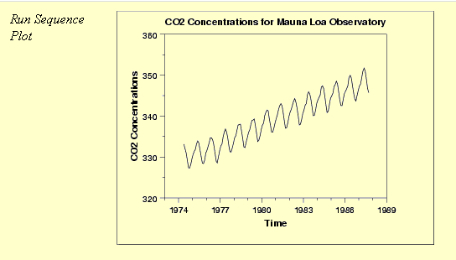
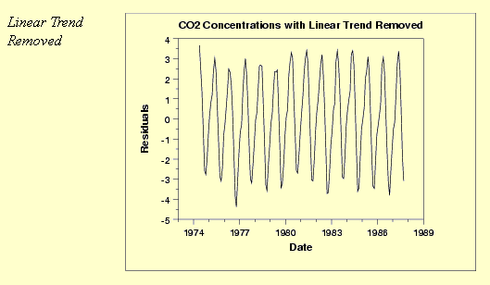
The initial run sequence plot of the data indicates a rising trend. A visual inspection of this plot indicates that a simple linear fit should be sufficient to remove this upward trend.
Tranformations to Achieve Stationarity
This plot also shows periodical behavior
This plot contains the residuals from a linear fit to the original data.
After removing the linear trend, the run sequence plot indicates that the data have a constant location and variance, although the pattern of the residuals shows that the data depart from the model in a systematic way.

Slide 15
Seasonality
Many time series display seasonality. By seasonality, we mean periodic fluctuations.
(For example, retail sales tend to peak for the Christmas season and then decline after the holidays. So time series of retail sales will typically show increasing sales from September through December and declining sales in January and February).
Seasonality is quite common in economic time series. It is less common in engineering and scientific data.
If seasonality is present, it must be incorporated into the time series model
The following graphical techniques can be used to detect seasonality.
Run sequence plot.
Seasonal subseries plot is a specialized technique for showing seasonality.
Multiple box plots can be used as an alternative to the seasonal subseries plot to detect seasonality.
The autocorrelation plot.

Slide 16
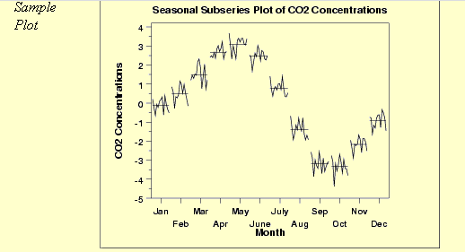
Seasonality – Seasonal Subseries Plot
Run sequence plot Is a recommended first step for analyzing any time series.
Although seasonality can sometimes be indicated by Run Sequence plot, seasonality is shown more clearly by the seasonal subseries plot or the box plot.
Seasonal Run Series plot does an excellent job of showing both the seasonal differences (between group patterns) and also the within-group patterns.
This seasonal subseries plot containing monthly data of CO₂ concentrations reveals a strong seasonality pattern. The CO₂ concentrations peak in May, steadily decrease through September, and then begin rising again until the May peak.
This plot allows to detect both between group and within group patterns.
NB: If there is a large number of observations, then a box plot may be preferable

Slide 17
Seasonality
The seasonal subseries plot can provide answers to the following questions:
Do the data exhibit a seasonal pattern?
What is the nature of the seasonality?
Is there a within-group pattern (e.g., do January and July exhibit similar patterns)?
Are there any outliers once seasonality has been accounted for?
Importance: It is important to know when analyzing a time series if there is a significant seasonality effect. The seasonal subseries plot is an excellent tool for determining if there is a seasonal pattern.

Slide 18
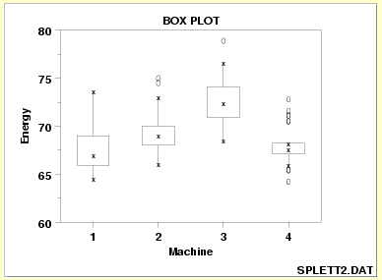
Seasonality
Box Plot:
Shows the seasonal difference (between group patterns) quite well, but it does not show within group patterns.
However, for large data sets, the box plot is usually easier to read than the seasonal subseries plot.
Excellent tool for conveying location and variation information in data sets, particularly for detecting and illustrating location and variation changes between different groups of data
This box plot, comparing four machines for energy output, shows that machine has a significant effect on energy with respect to both location and variation. Machine 3 has the highest energy response (about 72.5); machine 4 has the least variable energy response with about 50% of its readings being within 1 energy unit.
Both the seasonal subseries plot and the box plot assume that the seasonal periods are known. In most cases, the analyst will in fact know this.
For example, for monthly data, the period is 12 since there are 12 months in a year.
However, if the period is not known, the autocorrelation plot can help. If there is significant seasonality, the autocorrelation plot should show spikes at lags equal to the period.
For example, for monthly data, if there is a seasonality effect, we would expect to see significant peaks at lag 12, 24, 36, and so on (although the intensity may decrease the further out we go).

Slide 19
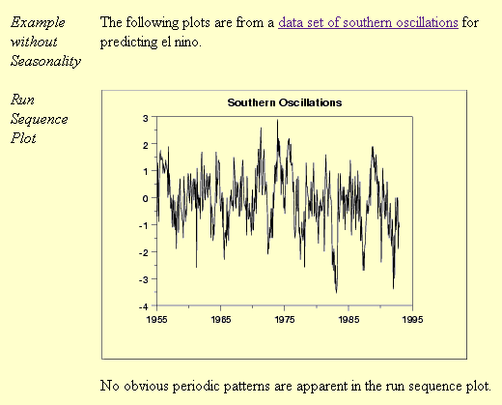
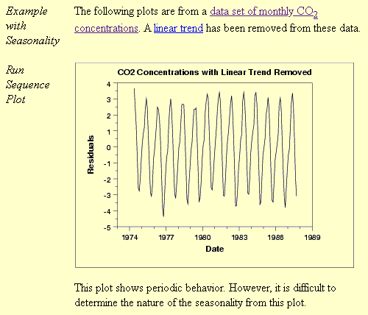
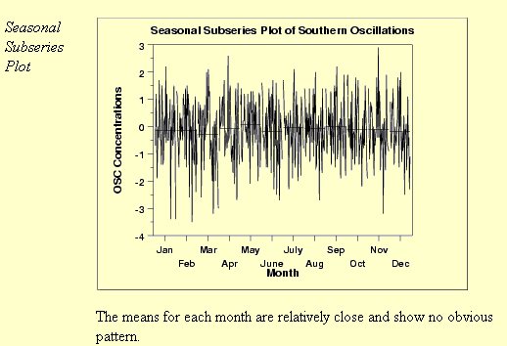
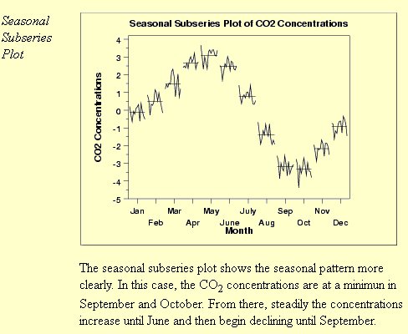
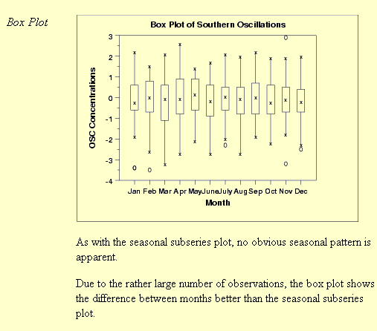
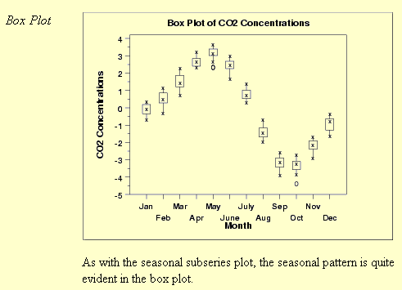

Slide 20
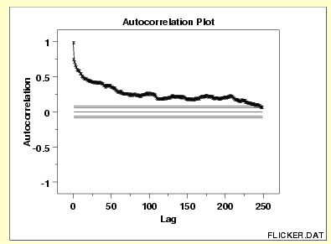
Autocorrelation plots
Autocorrelation plots are a commonly-used tool for checking randomness in a data set.
This randomness is ascertained by computing autocorrelations for data values at varying time lags.
If random, such autocorrelations should be near zero for any and all time-lag separations.
If non-random, then one or more of the autocorrelations will be significantly non-zero.
What do you make out of this autocorrelation plot?

Slide 21
Autocorrelation plots
Autocorrelation plots are a commonly-used tool for checking randomness in a data set.
This randomness is ascertained by computing autocorrelations for data values at varying time lags.
If random, such autocorrelations should be near zero for any and all time-lag separations.
If non-random, then one or more of the autocorrelations will be significantly non-zero.
This sample autocorrelation plot shows that the time series is not random, but rather has a high degree of autocorrelation between adjacent and near-adjacent observations.

Slide 22
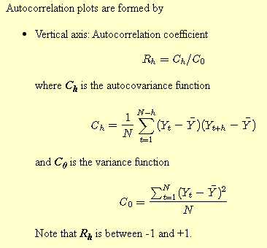
Autocorrelation plots

